Slide 1




Protecting your GitHub Repo with Jenkins
z

Slide 2
Agenda
What is Jenkins?
Configure Jenkins & GitHub Repo
Create Jenkinsfile
Protect Repo with Protected Branches/Jenkins
Make Changes to Repo
Audit Jenkins Logs
Demonstration
Questions

Slide 3

What is Jenkins?
Jenkins is an open source automation server written in Java. Jenkins helps to automate the non-human part of software development process, with continuous integration and facilitating technical aspects of continuous delivery.¹
1 - https://en.wikipedia.org/wiki/Jenkins_(software)

Slide 4
Configure Jenkins
Plugins and Installations
Configurations
Using Azure subscription for this demonstration.
Installed `golang` on server running Jenkins
Installed following Jenkins Plugins
Go Plugin
GitHub Organization Folder Plugin
GitHub Integration Plugin
Pipeline GitHub Notify Step Plugin
Pipeline: GitHub
Jenkins Location
Change Jenkins URL to valid URL
GitHub
Add GitHub Server
API URL
Credentials
PAT saved in Jenkins as Secret Text

Slide 5
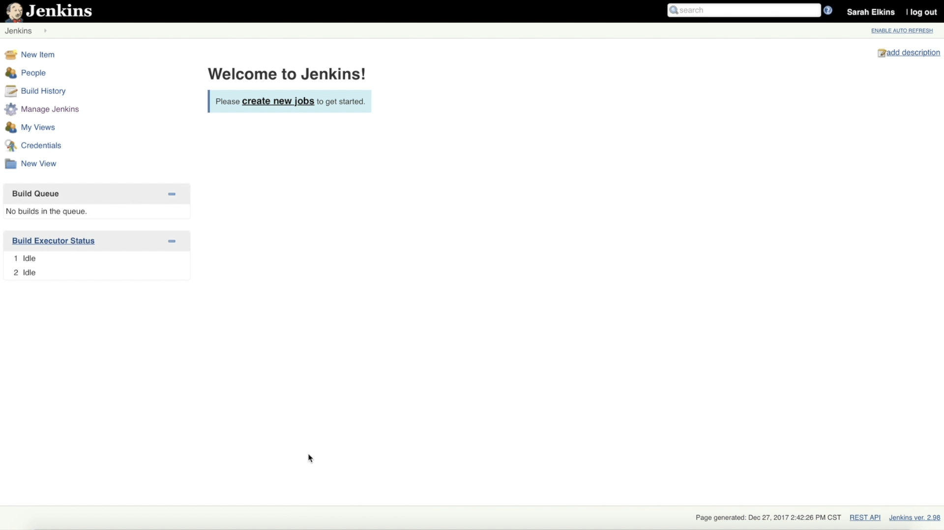
Configure Organization in Jenkins

Slide 6
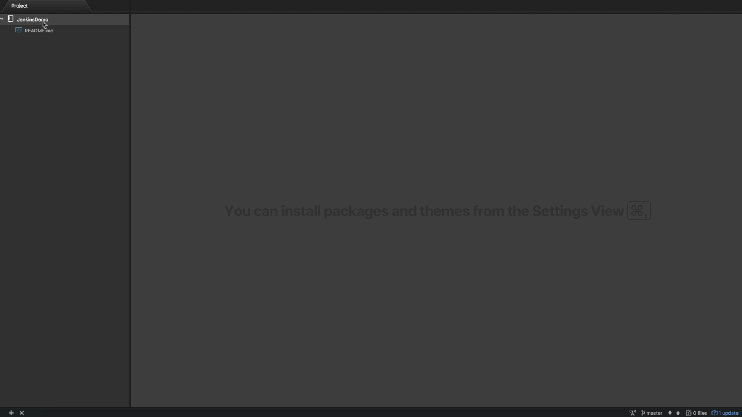
Create Jenkinsfile

Slide 7
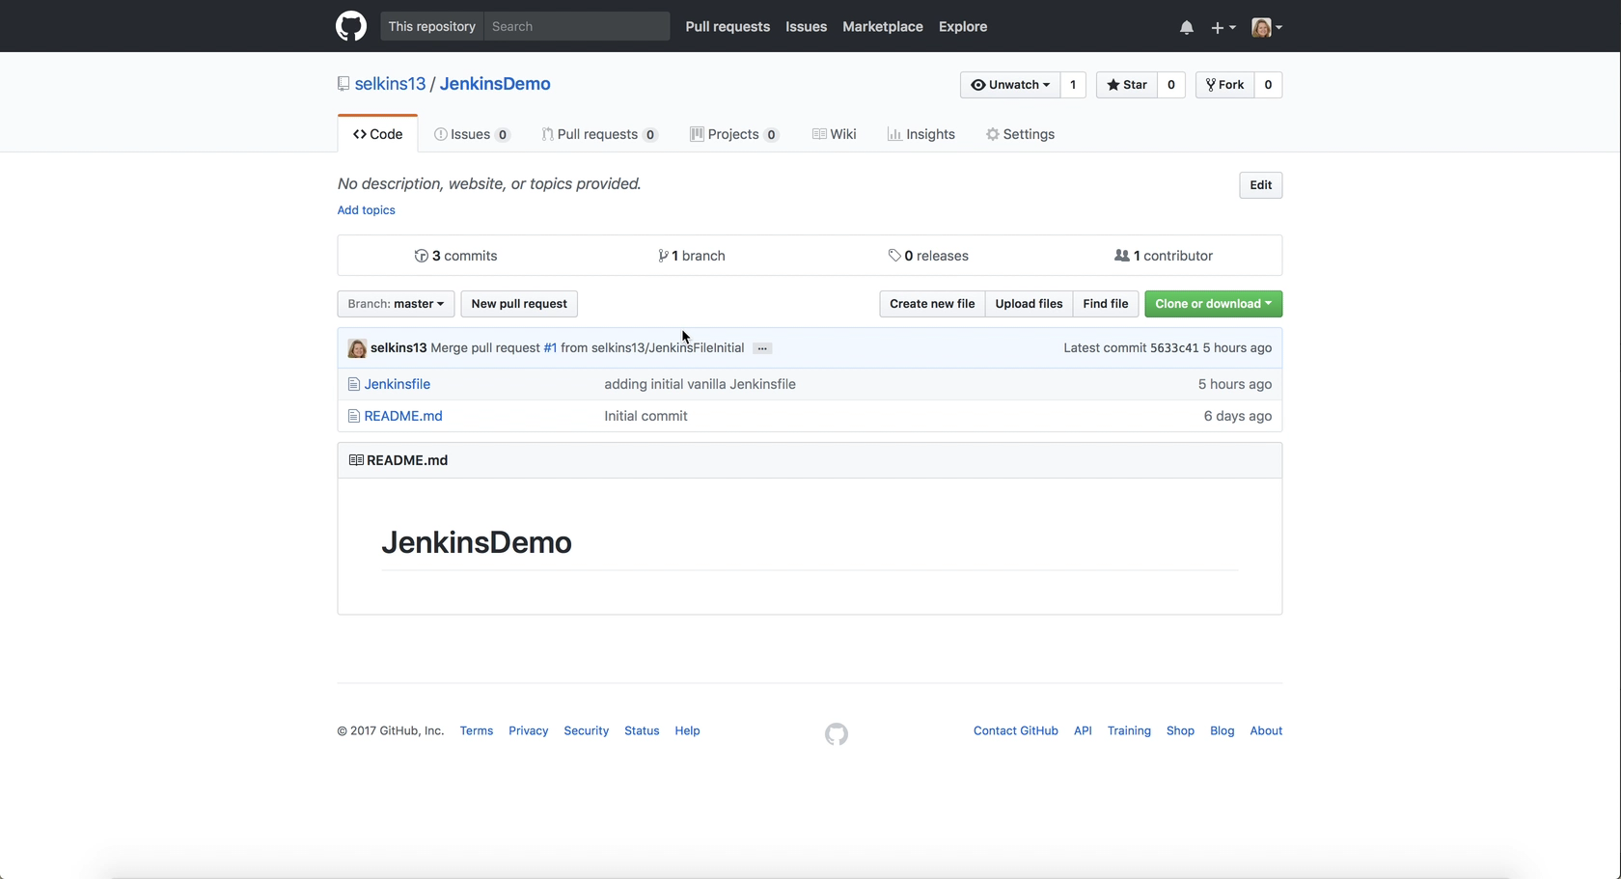
Configure GitHub Repository

Slide 8
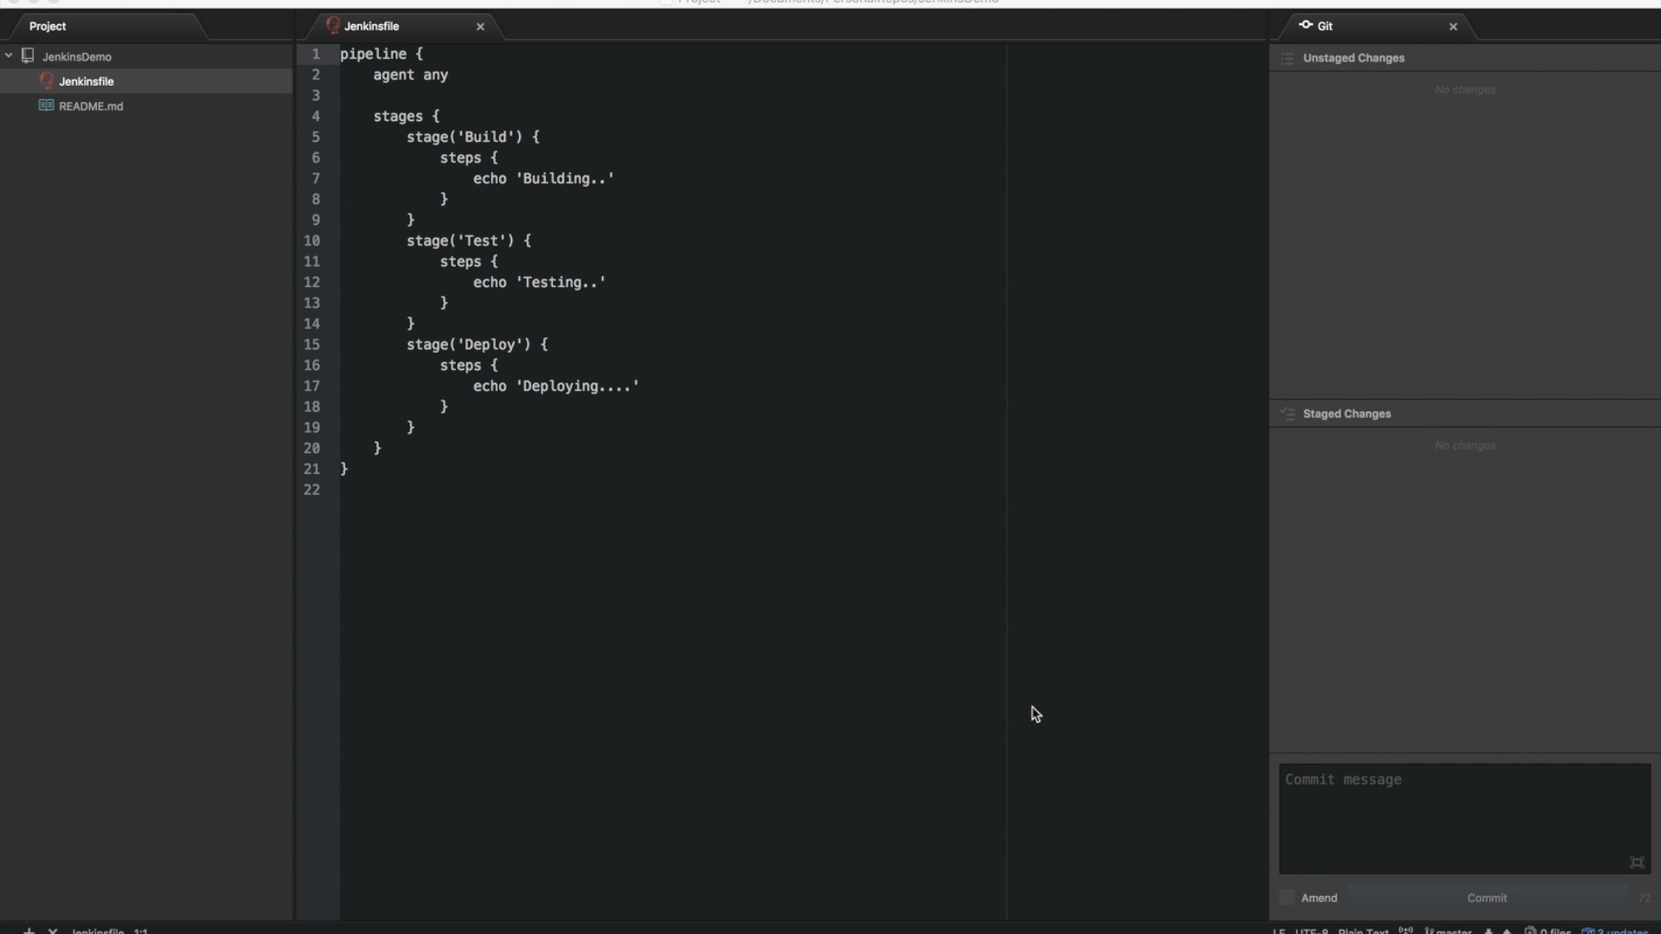
Make Changes

Slide 9
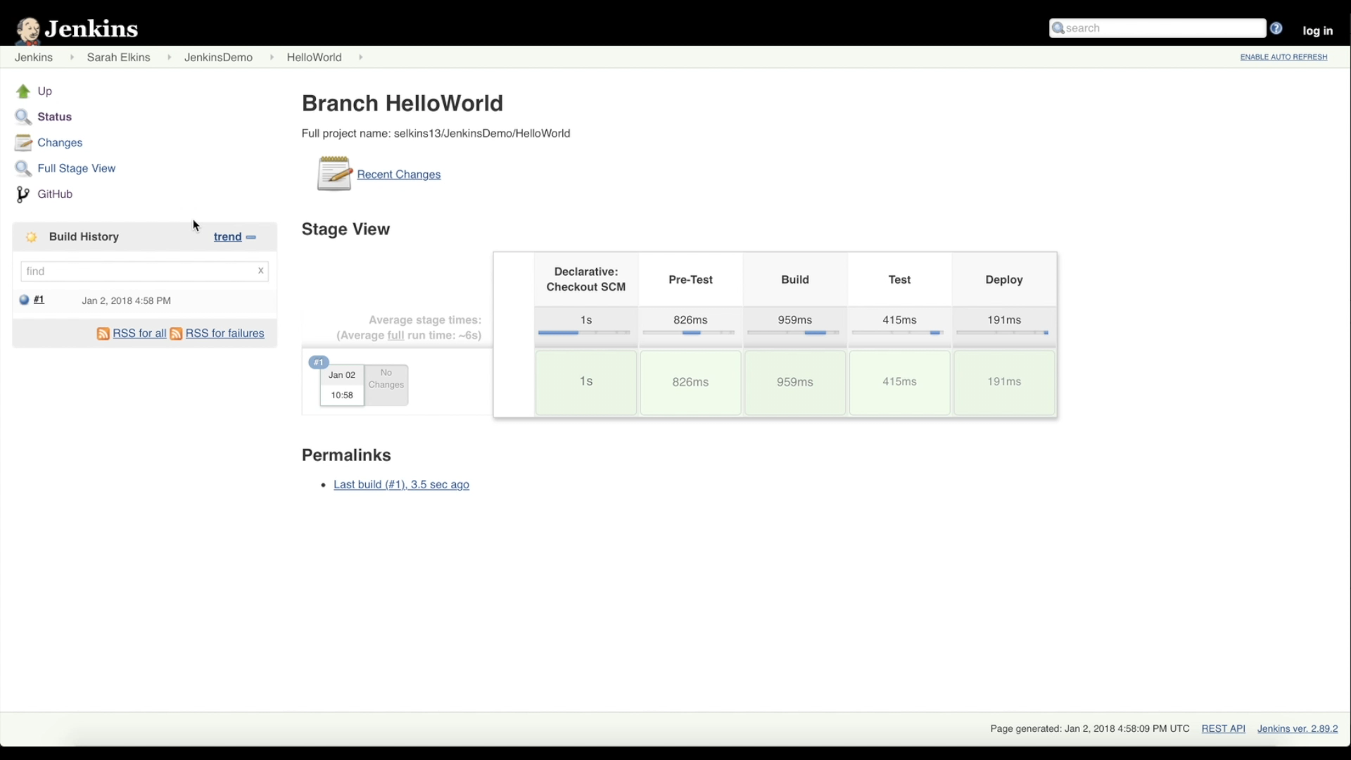
Jenkins Log Audit

Slide 10
Demonstration

Slide 11
Questions
“Learn avidly. Question repeatedly what you have learned. Analyze it carefully. Then put what you have learned into practice intelligently.”
–Edward Cocker

